Slide 1


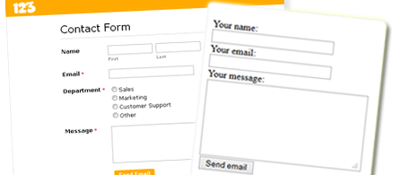

Working with Forms
HTTP GET / POST, Validation, Escaping, Submitting Arrays, URL Redirecting
SoftUni Team
Technical Trainers
Software University
http://softuni.bg

Slide 2
Questions
sli.do #PHP-WEB

Slide 3

Table of Contents
HTTP Request Methods
HTML Escaping & Data Validation
Query Strings
Checkboxes
Hidden Fields
Submitting Arrays
Other Input Types
URL Redirecting

Slide 4
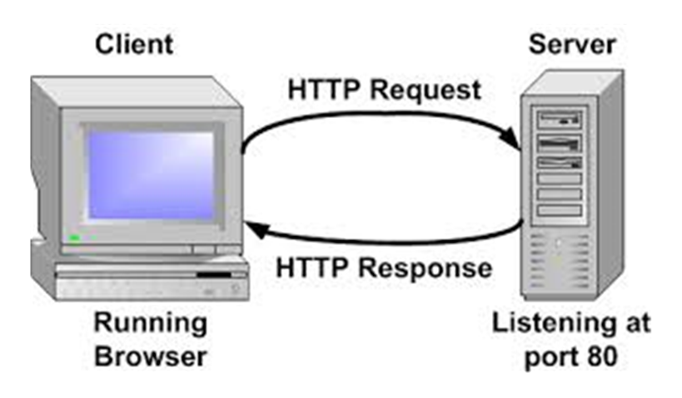
HTTP Request Methods
How Browsers Send Form Data?

Slide 5
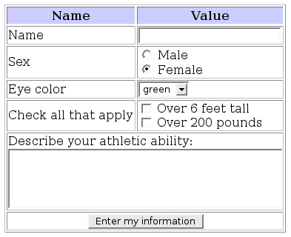
Web Page Loading
Browser
Server
PHP
localhost
GET /
Web Server
HTML Form
File System
POST /
Success
HTML Result

Slide 6
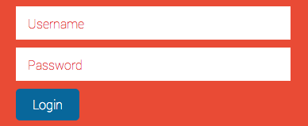
HTTP Request Methods
Forms allow the user to enter data that is sent to a server for processing via HTTP request methods
The most used HTTP request methods: GET and POST
In PHP the posted form data is stored in the $_GET or $_POST associative arrays

Slide 7

GET Request Method
HTTP GET
Retrieves data from the server from given URL
The form data is stored in $_GET associative array
The whole query string can be accessed using $_SERVER['QUERY_STRING'] environment variable
<form method="get" action="index.php">
…
</form>

Slide 8
GET Request Method – Example
<form method="get">
Name: <input type="text" name="name" />
Age: <input type="text" name="age" />
<input type="submit" />
</form>
<?php
// Check the keys "name" or "age" exist
if (isset($_GET["name"]) || isset($_GET["age"])) {
echo "Welcome " . htmlspecialchars($_GET['name']) . ". <br />";
echo "You are " . htmlspecialchars($_GET['age']). " years old.";
}
?>

Slide 9

POST Request Method
The POST method transfers data in the HTTP body
Not appended to the query string
The posted data is stored in $_POST associative array
By using https:// you can protect your posted data
POST can send text and binary data, e.g. upload files
<form method="post" action="index.php">
…
</form>

Slide 10
POST Request Method – Example
<form method="post">
Name: <input type="text" name="name" />
Age: <input type="text" name="age" />
<input type="submit" />
</form>
<?php
// Check the keys "name" or "age" exist
if (isset($_POST["name"]) || isset($_POST["age"])) {
echo "Welcome " . htmlspecialchars($_POST['name']) . ". <br />";
echo "You are " . htmlspecialchars($_POST['age']). " years old.";
}
?>

Slide 11

HTTP Request Methods
Live Demo

Slide 12
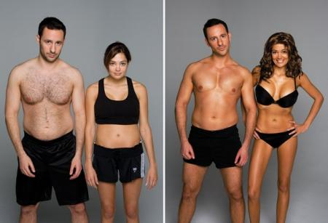
HTML Escaping & Data Validation

Slide 13
HTML Escaping: Motivation
Suppose we run this PHP script:
What if we enter the following in the input field?
<form method="get">
Enter your name: <input type="text" name="name" />
<input type="submit" />
</form>
<?php
if (isset($_GET["name"]))
echo "Hello, " . $_GET["name"];
?>
<script>alert('hi')</script>

Slide 14
HTML Escaping: htmlspecialchars()
htmlspecialchars(string)
Converts HTML special characters to entities: & " ' < and > become &amp; &quote; &#039; &lt; and &gt;
<form method="get">
Enter your name: <input type="text" name="name" />
<input type="submit" />
</form>
<?php
if (isset($_GET["name"]))
echo "Hello, " . htmlspecialchars($_GET["name"]);
?>

Slide 15
Principles of HTML Escaping
How and when the HTML escape?
HTML escaping should be performed on all data printed in an HTML page, that could contain HTML special chars
Any other behavior is incorrect!
Never escape data when you read it!
Escape the data when you print it in a HTML page
Never store HTML-escaped data in the database!
Never perform double HTML escaping

Slide 16
Example of Correct HTML Escaping
Sample form that can submit HTML special characters:
Example of correct HTML escaping (data only!):
<form method="get">
Name: <input type="text" name="name" value="&lt;br&gt;" />
<input type="submit" />
</form>
<?php
if (isset($_GET["name"]))
echo "Hi, <i>" . htmlspecialchars($_GET["name"] . "</i>");
?>

Slide 17
Example of Incorrect HTML Escaping
Sample form that can submit HTML special characters:
Example of incorrect HTML escaping (don't escape everything):
<form method="get">
Name: <input type="text" name="name" value="&lt;br&gt;" />
<input type="submit" />
</form>
<?php
if (isset($_GET["name"]))
echo htmlspecialchars("Hi, <i>" . $_GET["name"] . "</i>");
?>

Slide 18
Data Normalization
addcslashes() – escapes given list of characters in a string
quotemeta() – escapes the symbols . \ + * ? [ ^ ] ( $ )
htmlspecialchars() – convert special characters to HTML entities, as seen in examples
htmlentities() – escapes all HTML entities (£ → &pound;)
Escapes special symbols in a string: &, ", ', <, >
echo addcslashes("say('hi')", ';|<>\'"');
// Result: say(\'hi\')
echo htmlentities("A '£' is <b>bold</b>");
// Outputs: A '&pound;' is &lt;b&gt;bold&lt;/b&gt;

Slide 19
PHP Automatic Escaping Engine - WARNING!
PHP supported the magic_quotes engine
It escapes all necessary characters in the $_GET, $_POST and $_COOKIE array automatically
In versions before 5.2 it is turned on by default
Considered dangerous approach - deprecated in PHP 5.4
DO NOT USE IT!!!
Developers should handle escaping manually

Slide 20
Validating User Input
Data validation ensures the data we collect is correct
May be performed by filter_var() in PHP
<?php
$ip_a = '127.0.0.1';
$ip_b = '42.42';
if (filter_var($ip_a, FILTER_VALIDATE_IP)) {
echo "This (ip_a) IP address is considered valid.";
}
if (filter_var($ip_b , FILTER_VALIDATE_IP)) {
echo "This (ip_b) IP address is considered valid.";
}
?>

Slide 21
Validating User Input (2)
<form>
<input type="text" name="num" />
<input type="submit" />
</form>
<?php
if (isset($_GET['num'])) {
$num = intval($_GET['num']);
if ($num < 1 || $num > 100) {
echo "Please enter an integer number in range [1..100].";
die;
}
echo "You entered valid number: $num.";
}
?>

Slide 22

HTML Escaping & Data Validation
Live Demo

Slide 23
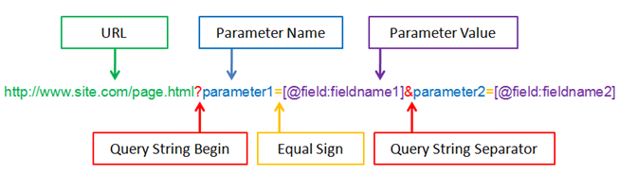
Query String

Slide 24
What is a Query String?
A query string is a part of a URL following a question mark (?)
Commonly used in searches and dynamic pages
Accessed by $_SERVER['QUERY_STRING']
<form>
<input type="text" name="firstName" />
<input type="submit" />
</form>
<?php
echo $_SERVER['QUERY_STRING'];
?>

Slide 25

Creating a Query String
Most common way is by using a form with a GET method
You can also use scripts to add to the query string or simply write your links with the query strings in the href attribute

Slide 26
Query String
Live Demo

Slide 27

Working with Checkboxes

Slide 28
Checkoxes
Checkboxes are created by setting an input with type "checkbox"
<input type="checkbox" name="two-way-ticket" />
A checkbox is only submitted if it's actually checked
if (isset($_GET['two-way-ticket']) ) {
echo "Two-way ticket";
} else {
echo "One-way ticket";
}

Slide 29

Checkboxes
Live Demo

Slide 30

Hidden Fields

Slide 31
Hidden Fields
Created by setting the type of input to hidden
Submit information that is not entered by the user
Not visible to the user, but visible with [F12]
<form method="post">
<input type="text" name="user" />
<input type="submit" />
<?php if (isset($_POST['user'])) { ?>
<input type="hidden" name="hiddenName"
value="<?php echo sha1($_POST['user']) ?>" />
<?php } ?>
</form>
Applies sha1 hashing to a string

Slide 32
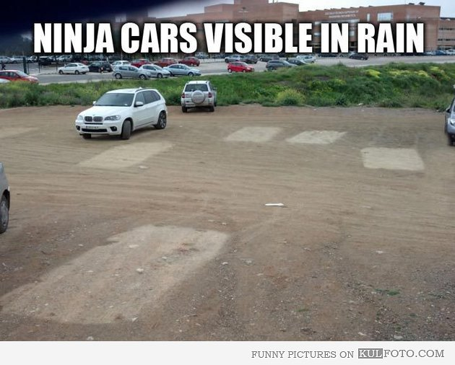
Hidden Fields
Live Demo

Slide 33
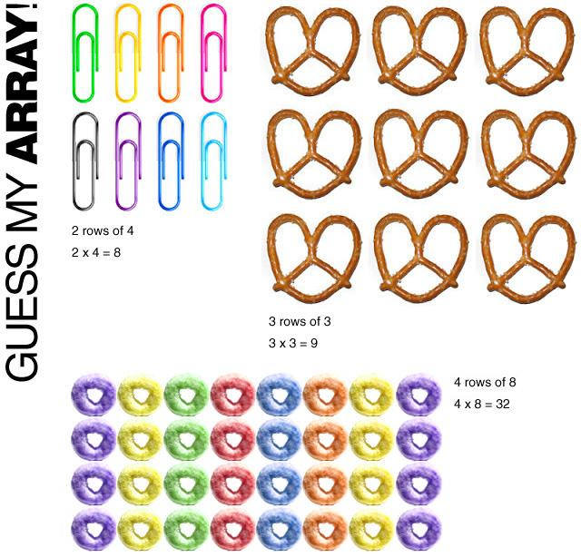
Submitting Arrays

Slide 34
Submitting Arrays
In order for an input to be treated as an array, you must put brackets "[]" in the name attribute:
<form method="post">
<select name="people[]" multiple="multiple">
<option value="Mario">Mario</option>
<option value="Svetlin">Svetlin</option>
<option value="Teodor">Teodor</option>
</select>
<input type="submit" value="submit"/>
</form>

Slide 35

Submitting Arrays (2)
The selected form elements come as an array:
<?php
if (isset($_POST['people'])) {
foreach($_POST['people'] as $person) {
echo htmlspecialchars($person) . '</br>';
}
}
?>

Slide 36

Submitting Arrays
Live Demo

Slide 37

Other Input Types

Slide 38
Other Input Types
Radio, date, datetime, time, number, range, color, …
<form method="post">
Male <input type="radio" name="gender" value="male" /> <br/>
Female <input type="radio" name="gender" value="female" /> <br/>
<input type="submit" value="submit"/>
</form>
<?php
if (isset($_POST['gender'])) {
$selected_radio = $_POST['gender'];
echo "Selected: $selected_radio";
}
?>

Slide 39
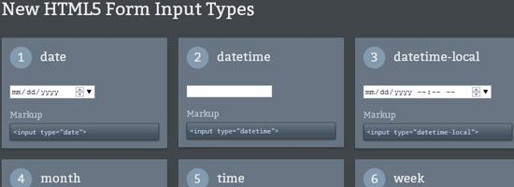
Other Input Types
Live Demo

Slide 40



Redirecting the Browser

Slide 41
Redirecting the Browser
Done by using the HTTP "Location" header
This sends HTTP 302 "Found" in the HTTP response status code
Tells the browser to open a new URL
header('Location: http://softuni.bg');

Slide 42

Redirecting the Browser
Live Demo

Slide 43

Summary
HTTP request methods – GET, POST, etc.
Normalization and validation
Working with query strings
You can easily combine PHP and HTML
You can get input as array
Special input fields – checkboxes, hidden fields

Slide 44








Working with Forms
https://softuni.bg/courses/php-basics/

Slide 45
License
This course (slides, examples, demos, videos, homework, etc.) is licensed under the "Creative Commons Attribution-NonCommercial-ShareAlike 4.0 International" license
Attribution: this work may contain portions from
"PHP Manual" by The PHP Group under CC-BY license
"PHP and MySQL Web Development" course by Telerik Academy under CC-BY-NC-SA license

Slide 46





Free Trainings @ Software University
Software University Foundation – softuni.org
Software University – High-Quality Education, Profession and Job for Software Developers
softuni.bg
Software University @ Facebook
facebook.com/SoftwareUniversity
Software University @ YouTube
youtube.com/SoftwareUniversity
Software University Forums – forum.softuni.bg

